Slide 1
Sustaining Identity with Change: the Role of Intangible Cultural Heritage
Marilyn Truscott
National Identity and Global Education Forum
23-24 March 2018
ANU Intercultural Dialogue Association

Slide 2
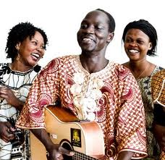
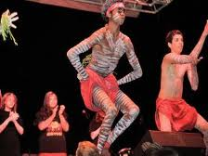
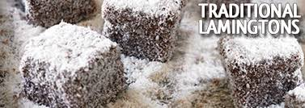
Aims
Who are we?
Living Heritage - Identity
Examples of Sustaining Intangible Cultural Heritage
Seeing, Sharing, Understanding?
Best Practice

Slide 3
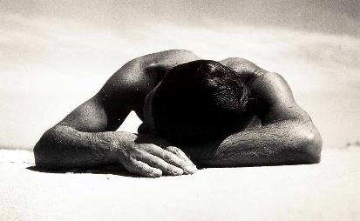
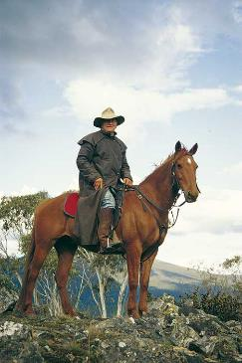
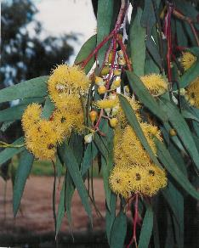
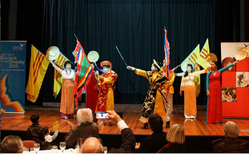
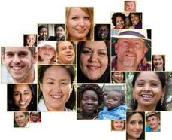
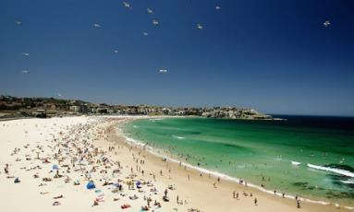
Australia: a Place of Migration Heritages
Who we are – our Story
Most of us have left ‘place’ behind – transplanted to a new ‘Home’:
Displaced?

Slide 4
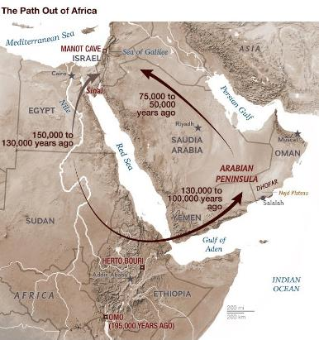
Yet Australia a very early ‘out of Africa’ settlement
Homo sapiens sapiens out of Africa
Recent dates in Arabia: 130,000 years ago
(Jeff Rose University of Birmingham 2010)
Arrival in Australia date currently at least
65,000BP
possibly more

Slide 5
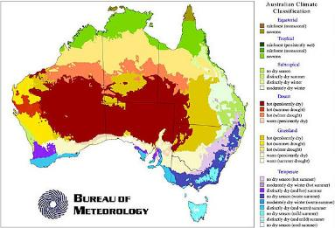
with a long stay in one place … on ‘Country’
Very early and rapid spread around coast
then throughout continent
Loss of coastal areas—of place—increased desertifcation
at end of Pleistocene – 12,000-8000BP
Still a very big continent, now very dry
Long-standing continuity of groups in one place
(DNA evidence, March 2017)
Some 300 languages and cultures
at time of 1788 European colonisation
hunter-gatherer cultures – estimated population 750,000
2016 census: c650,000
3% of Australians

Slide 6
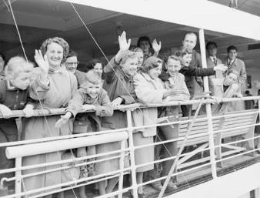
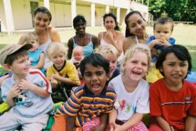
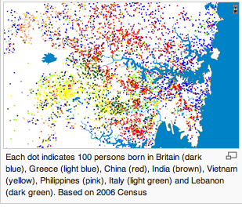
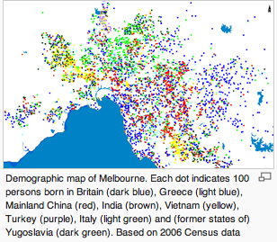
Waves of Migration
For a better life or refuge from conflict, eg:
1850s Gold Rush – Europeans Chinese, doubling population
1860s-1920s Lebanese
post-WWII – assisted migration, 1 million migrants, British, eastern and southern Europeans
1945 population = 7 million
1959 population = 10 million
1960s-70s – Chileans, economic and political reasons
post-1975 – ‘American’ War in Vietnam: Vietnamese (80,000), Laotians, Cambodians
International students staying on:
Chinese, Indians and recently Brazilians
More and diverse asylum seekers in recent years
Africa – various countries
Middle East and Afghanistan ...

Slide 7
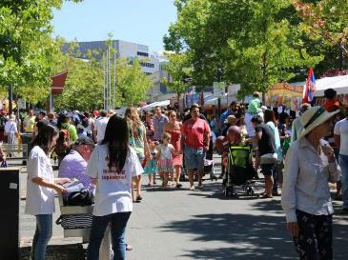
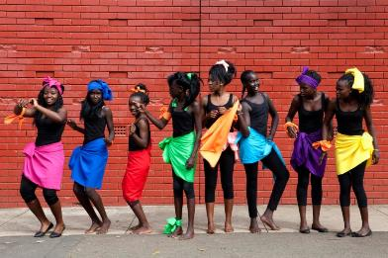
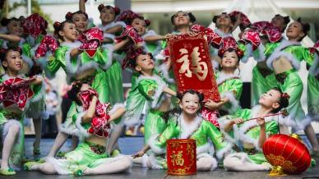
Who are Canberrans?
% of Australians: 1.6
Fewer Canberrans born o/s in 2011 than 1961
1911 census: 10% born o/s = 179 people (most in Britain / Ireland, only 10 born outside Europe (Indigenous ‘Canberrans’ on reserves in Yass)
1961: 27% born o/s: England, Germany, Italy most common, with 4% of born o/s from Asia
2011: only 24% born o/s, BUT of these 39% born in Asia
and from overall 180 countries of birth
45% Canberrans had one parent or both born o/s
Citizenship uptake at that time from South Africa, UK, Sri Lanka, Pakistan, Philippines, Vietnam …
2016: 32% born o/s:
England (3.2%), China (2.9%), India (2.6%), New Zealand (1.2%), Philippines (1%), other (21.1%)
Languages at home (English only 72%):
Mandarin (3.1%), Vietnamese (1.1%), Cantonese (1%), Hindi (0.9%), Spanish (0.8%), other (21.1, German slipped to below 7th most common)
1.6% are Indigenous (not all local descendants)

Slide 8
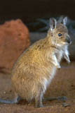
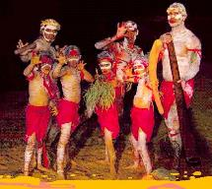
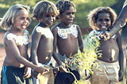
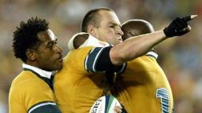
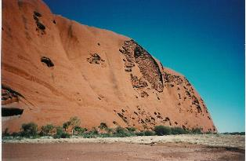
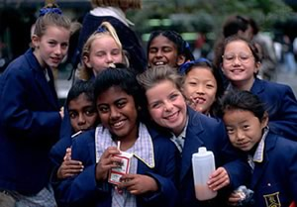
Today’s Transplanted Cultures
Australia’s diverse society = 24 million:
3% are Indigenous (many mixed)
33.3% born overseas – ‘transplanted’
(61% from non-English speaking countries)
47% have at least one parent born overseas
260 languages spoken
(60 being Indigenous languages - once c300)
‘Multi-Cultural’ public policy since 1973
(right to retain cultural identity / heritage)
(social justice to all)
So do migrants maintain and sustain a ‘living heritage’ without developing
a ‘sense of place’?

Slide 9
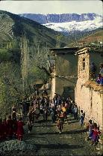
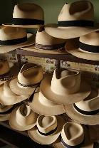
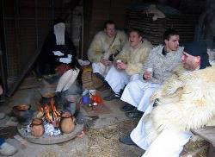
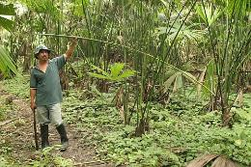
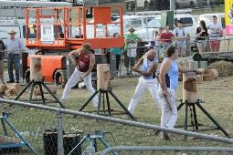
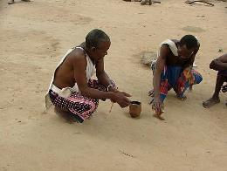
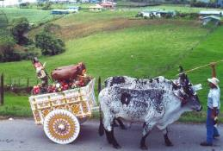
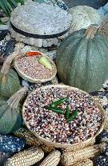
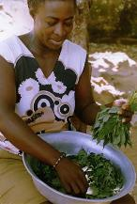
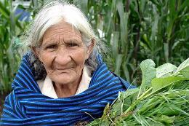
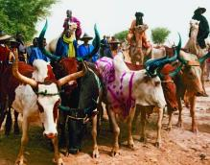
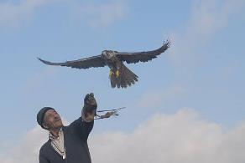
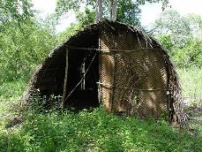
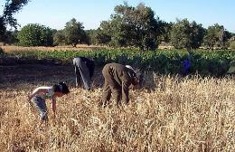
‘A Sense of Place’
A community’s sense of place includes both Intangible and Tangible Cultural Heritage:
springing from the environment where a people lives, lived, formed in part by the environment:
food tools building materials stem from the environment
cosmological explanations and belief systems are formed by the space a community dwells in
adapting as the environment changes
shifting as skills develop to form and forge different economies and social beliefs and practices
but continuing with change from the past to the future as part of a community’s identity:
its Living Heritage, its Living Culture …

Slide 10
Living Heritage / Culture and Change
A community’s sense of place includes both Intangible and Tangible Cultural Heritage:
Intangible Cultural Heritage can perhaps continue despite displacement to a new environment:
“intangible cultural heritage” means the practices, representations, expressions, knowledge, skills – as well as the instruments, objects, artefacts and cultural spaces associated therewith – that communities, groups and, in some cases, individuals recognize as part of their cultural heritage. …
(UNESCO ICH Convention 2003 Article 2)
Australia has not signed up to this Convention but some current heritage practice recognises ICH as a key aspect of community identity and culture …

Slide 11
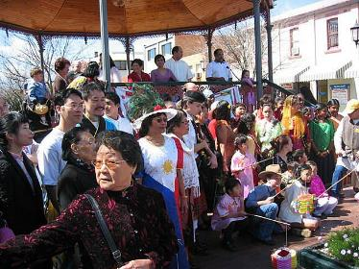
Recognition of Living Heritage in Place?
It is disappointing that the ACT government in the review of the Heritage Act in 2010 answered the recommendation that intangible heritage be included in the legislation (which broadly recognises it with the ‘social value’ criterion) by stating that such heritage would continue to be celebrated at such multicultural festivals and not formally as ‘heritage’

Slide 12
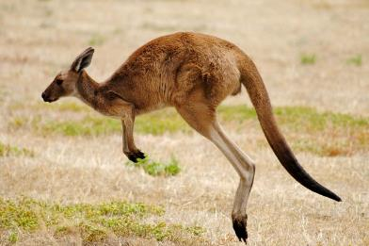
Displaced / Transplanted Cultures
linking Intangible Heritage to new Place
How is this happening?
A colonial example was the search for identity:
a new sense of place in 1890s pre-Federation,
poets, artists: inventing a new identity for ‘Australians’
- the Bush myth in a highly urban society
eg Man from Snowy River
- valuing flora fauna in design
(as part of Arts and Craft Movement)
Ignoring the diversity of migrant groups
already in Australia
In 19thC Australia over 25% were
non-Anglo/Celt:
Afghan cameleers
Lebanese and Greek merchants
Chinese miners etc etc etc

Slide 13
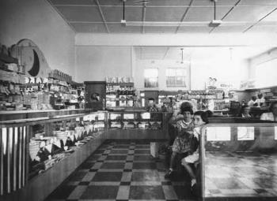
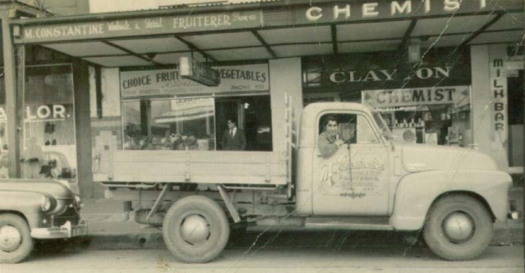
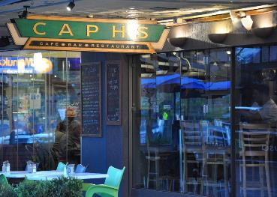
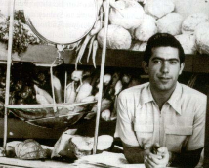
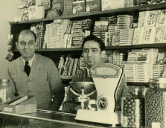
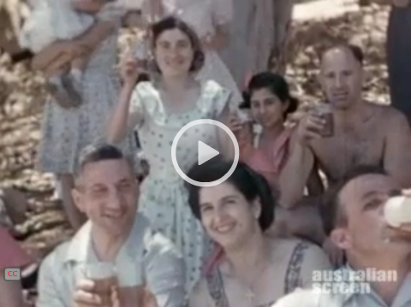
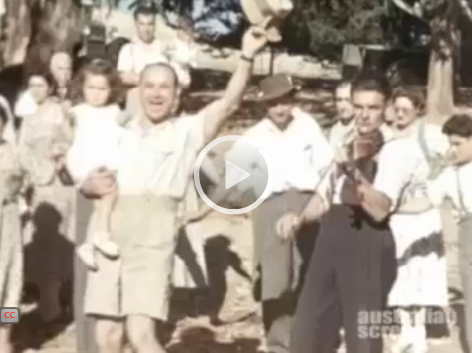
Keeping Culture – Finding Place?
But many groups bucked this rural myth, building their own sense of place, community and continuity. The Greek community came when Canberra first built as the capital, providing commercial acitivity: cafés, green grocers from 1926 …
Yet no places / buildings identified in heritage listings for such groups, also other connections with place / landscape have been ignored.
Greek community annual picnic, at Good Hope, still continues

Slide 14
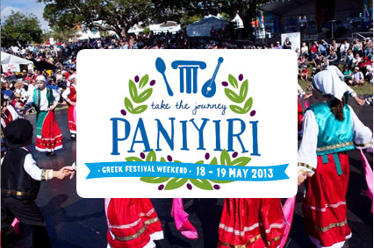
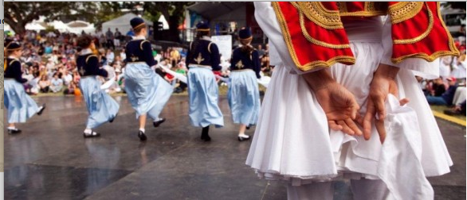
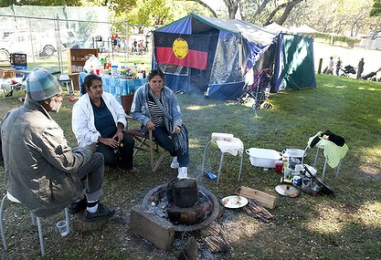
Keeping Culture – Sharing Place?
Without being centred in place how do cultural communities maintain, sustain their ICH?
As said, connecting with place can be central to identity
The Greek community in Brisbane has formed a tradition to meet at a city park, Musgrave Park, that has developed into a major centre for a traditional annual festival – Paniyiri – to celebrate and share Greek ICH: food, music, song, dance
The Greek community now has a cultural centre there
It has become a ‘cultural space’ for this group
The same park is a pre‑contact Indigenous traditional site, continuing as camp during early settler contact – now a protest site for Indigenous rights
The Indigenous community has been promised an Aboriginal cultural centre – where ongoing ICH can be shared – but state government stalling

Slide 15
Keeping Culture – Sharing Place?
And despite the conflict with the government by the Aboriginal groups, they continue to celebrate their culture at the park
Such as at the annual National Aboriginal and Islander Day in July each year
There is no dispute between Greek and Aboriginal groups
But different groups having different heritage values for the same place may come into conflict
Australia ICOMOS 1998 Code on the Ethics of
Co-existence in Conserving Significant Places provides a way forward for such issues, assuming:
(i) the healthy management of cultural difference is the responsibility of society as a whole;
(ii) in a pluralist society, value differences exist and contain the potential for conflict; and
(iii) ethical practice is necessary for the just and effective management of places of diverse cultural significance.

Slide 16
Keeping Culture?
Without being centred in place how do cultural communities maintain, sustain their intangible cultural heritage?
c200,000 Vietnamese in Australia
75% in Sydney / New South Wales
(most arrived since 1975 as refugees)
Food & Festivals = general public contact
Vietnamese Womens Association in NSW
Provides social services to Vietnamese women and their families including:
Support information
English classes and referral
Tiny Mai & My Time Special Needs Play
Yet despite areas such as Cabramatta, Sydney, where an ethnic community initially lives in one urban area, usually the next generation moves out, and also many ‘marry out’
‘cultural spaces’ may not continue …

Slide 17
Moving Landscapes?
Place: displaced – replaced?
Yet despite no ‘ghettos’ forming, community members dispersing, there are places of Vietnamese community ‘connection’
Royal National Park is popular to visit, although the wildness of the native Australian landscape is challenging, picnicking is a reminder of familiar landscapes back home
– although not paddy fields!

Slide 18
Moving Landscapes?
Place: displaced – replaced?
Macedonian migration – initially no women, and traditional social dances not available, so picnics started in Royal National Park
now a strong Macedonian-Australian community tradition:
large picnics … where people could eat, drink and play music, were a hybrid tradition, influenced by outdoor celebrations that occurred in the homeland though inflected by the Australian context.

Slide 19
Continuity …
300,000 Turks in Melbourne
Food & Festivals = general public contact
Australian Turkish Association:
Immigration support services
Family counselling and support
Newly arrived settlement services
Employment support services
Youth camping programns
Youth counselling program
Women’s group
Elderly persons group
Folk dancing program
Community advocate
Information and referral program
Low income family camp program
Marhaba outreach to mainstream youth

Slide 20
But Challenges for Cultural Continuity
Australian Turkish Association (2009):
Isolation - In general, the Turkish speaking families often feel isolated due to the loss of community identity and close connections and community networks that were central to their living in their home country. Many of the elderly and frail citizens experience isolation due to physical and linguistic constraints … and lack of awareness of available sources of support.
Youth Issues - Young people from Turkish background grow in a community that encourages them to preserve their culture, language and heritage while fitting in with the mainstream society and their peers. This can be a challenge as they are two worlds that contradict each other ... can often lead to family breakdowns

Slide 21
Challenges for Cultural Continuity
Identity – despite above community bonds remain strong in Turkish community, less ‘marrying out’ than among other groups
BUT ambivalence about identity – perhaps in contrast to young Indigenous:
“‘You Have to be Anglo and Not Look Like Me’: identity and belonging among young women of Turkish and Latin American backgrounds in Melbourne, Australia’ (Zevallos 2008)
And ambivalence among 2nd generation of all NESB migrants of benefit of:
(SBS 2002)
Would formal acknowledgement of Intangible Cultural Heritage provide a greater pride in their particular identity within wider Australian mix?

Slide 22
Continuity of Intangible Heritage Faith, Food, and Festivals
Migrants bring cultural traditions that are movable: their food*, their feast days, their expressions of faith
Food is recognised as a common means of linking with others as one group’s food becomes popular with others … a way of connecting with place
* If available!

Slide 23
‘Home’: Keeping Culture?
Cultural identity via religion is often held onto more strongly than home country:
churches, mosques, synogogues, temples, etc, these buildings are symbols of continuity
form communities in a new place and reinforce a sense of identity
and a strong ‘sense of place’ is also achieved
Moslem communities have begun a National Open Mosque Day as part of a cultural understanding program, given current global anti-Islam rhetoric

Slide 24
Linking Communities at Place
Cultural Centres: food and feast-days
Canberra’s a gathering place available to all cultural groups for events – such as many smaller / newer ethnic / religious groups …
Ramadan feast Venezualan Indigenous gathering
Theo Notaras Multicultural Centre
Clubs: Larger/older groups: eg Croatian, Greek, Italian, Polish, Vietnamese ...

Slide 25
MultiCultural Festivals Popular
Are festivals sufficient as an expression of cultural continuity?
Are multicultural festivals merely ‘displaced heritage’?
They do not replicate dates / seasons / reasons for traditional practice
Yet a chance to display traditions – still ‘living heritage’?
A chance to share with others: wider society, other diverse groups
Yet disconnected from place …

Slide 26
Sharing Migrant Living Culture with Change
Various government funded migration heritage projects, eg:
New South Wales Migration Heritage Centre (Sydney)
(www.migrationheritage.nsw.gov.au)
Immigration Museum – Museum Victoria (Melbourne)
Immigrant Stories: (https://museumvictoria.com.au/immigrationmuseum/)
Jose Alonso and Gaston Arias …Two men who left the political turmoil of their beloved homelands to migrate to Australia. Yet their experiences could not be more different
The Eid brothers come to Melbourne from Lebanon
Migration Museum, Adelaide
(http://migration.history.sa.gov.au)
OzAsia 2013As part of the OzAsia festival
we explored the various traditions
associated with weddings in Malaysia.

Slide 27
Sharing and Understanding Migrant Heritage
Illawarra Migrant Heritage Project at industrial city Wollongong (NSW)
Suggesting to NESB migrant groups things they can do to understand and share their heritage:
Keep and create records
Write captions for photos
Make sketches from memory
Research family history of migration
Compile family trees, chain migration trees and timelines
Group discussions about migration experience
Use websites
Research and record objects, traditions and places
Assess the significance of objects and places
A guide provides questions on key themes: work, creating communities, and home and family, with suggestions on what evidence might support the story

Slide 28
Issues for Migrant Heritage
‘Heritage identification’ is acknowledging what we value from our past and present culture/s
Yet recognition is in separate systems (eg UNESCO):
Place and objects are separated into different statutory systems
Places are separated into ‘natural’ and ‘cultural’, and into Indigenous and
non-Indigenous
Intangible is often not considered

Slide 29
Heritage as Living Culture
For people do not separate their sense of culture, their heritage, their identity into different elements –
from grandma’s teapot to the food they cook, to their everyday idioms, to traditional festivals and the spaces where all this takes place …

Slide 30
Example of Past Practice
A focus in the past was on the physical – tangible aspects of place / object.
Disciplines with such skills dominated. Buildings / structures identified for their physical nature, architectural style, and historic role. There was no contact with the associated community.
Examples range from city buildings, housing, rural ‘icons’ (eg woolsheds), etc. An example of crossing over to another cultural element arose from the gold mining history from 1850, so that Chinese sites were recorded throughout Australia.
Today Chinese communities’ longstanding heritage connections are well understood, their voice central to decisions …

Slide 31
Community Value – Living Heritage
A growing understanding of community values over past
30 years, strengthened by criterion ‘social value’:
the place has … heritage value … because of the place's strong or special association with a particular community or cultural group for social, cultural or spiritual reasons
(Australia’s ‘social value’ – criterion g - for both place and object heritage)
Principles applicable to Intangible Cultural Heritage

Slide 32
Community Participatory Practice
Conservation, interpretation and management of a place should provide for the participation of people for whom the place as special associations and meanings, or who have social, spiritual or other cultural responsibilities for the place.
(Australia ICOMOS Burra Charter Article 12 – Participation)
And increasing recognition of
cultural space and landscapes
and its layers
Community Cultural Mapping

Slide 33
Linking Community Place, Object, ICH
Cultural Mapping links all aspects of a group’s heritage – connecting tradition, practice, story, objects, people, place:
the geography of oral tradition (Tobias 2000, Canada)
(other terms: Land Use and Occupancy Mapping / Map Biographies)
eg in Canberra recent 50th anniversary of suburb of Curtin providing opportunity to ‘map’ memories of place, traditions– story-telling by all different groups: diverse cultural / interest communities etc

Slide 34
Community Control and Continuity of ICH
Recognising community diversity and its ‘intangible cultural heritage’
Late 2017 Australia ICOMOS issued a ‘Practice Note’ -
a guideline, on connecting living heritage at place
It acknowledges that the importance of cultural practices is determined by the communities and groups of people for whom these practices form part of their cultural heritage, and are therefore an ‘intangible cultural heritage’ as defined in the UNESCO Convention.
Budj Bim AFL traditions Musgrave Park, Brisbane Broken Hill
Indigenous Ancestral Cultural Identity Indigenous site Cultural Figure Identity also Greek Paniyiri
Worth a look
(http://australia.icomos.org/wp-content/uploads/Practice-Note_Intangible-Cultural-Heritage-Place.pdf)
Marilyn Truscott SIETAR & ANU 2018

Slide 35
Sources
References:
Ang, Ien, Jeffrey E Brand, Greg Noble and Derek Wilding 2002 Living Diversity: Australia’s Multicultural Future, Special Broadcasting Commission
Illawarra Migration Heritage Project (http://www.mhpillawarra.com)
Thomas, Mandy 2002 Moving Landscapes: National Parks and the Vietnamese experience, Studies in the Cultural Construction of Open Space, NSW National Parks and Wildlife Service
Thomas, Martin 2001 A Multicultural Landscape: National Parks and the Macedonian Experience, Studies in the Cultural Construction of Open Space, NSW National Parks and Wildlife Service
Zevallos, Zuleyka 2008 "'You Have to be Anglo and Not Look Like Me': identity and belonging among young women of Turkish and Latin American backgrounds in Melbourne, Australia", Australian Geographer 39(1):21–43
Others to be shared in paper
Images:
UNESCO Intangible Cultural Heritage List
http://www.unesco.org/culture/ich/index.php?pg=00011
UNESCO World Heritage List
http://whc.unesco.org/en/list
Otherwise Marilyn Truscott / shared later – mct-oz@bigpond.net.au

